Slide 1
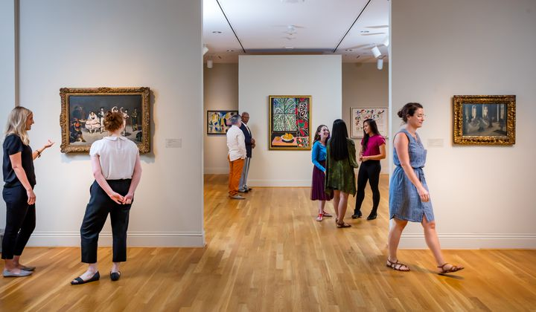

Using Machine Learning and Superimposition based Augmented-Reality to Provide Artistic Insight into Abstract Art
FIRE170 | Phillips Virtual Culture
Glen Joy

Slide 2
Motivation

Slide 3
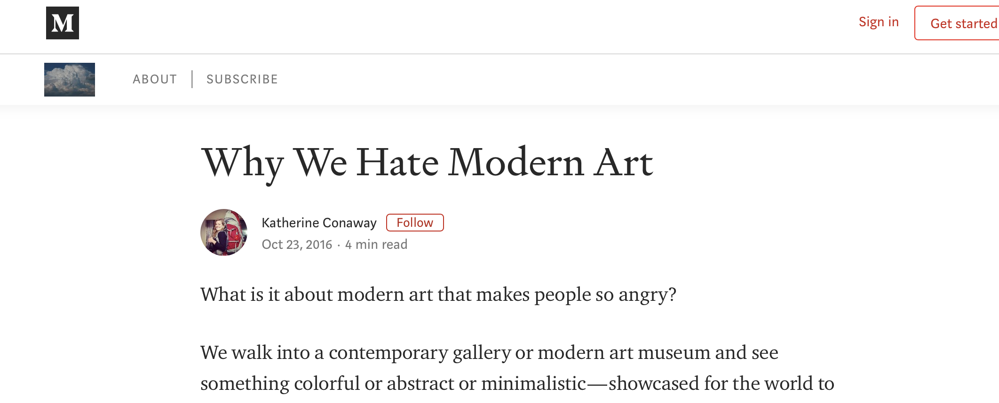
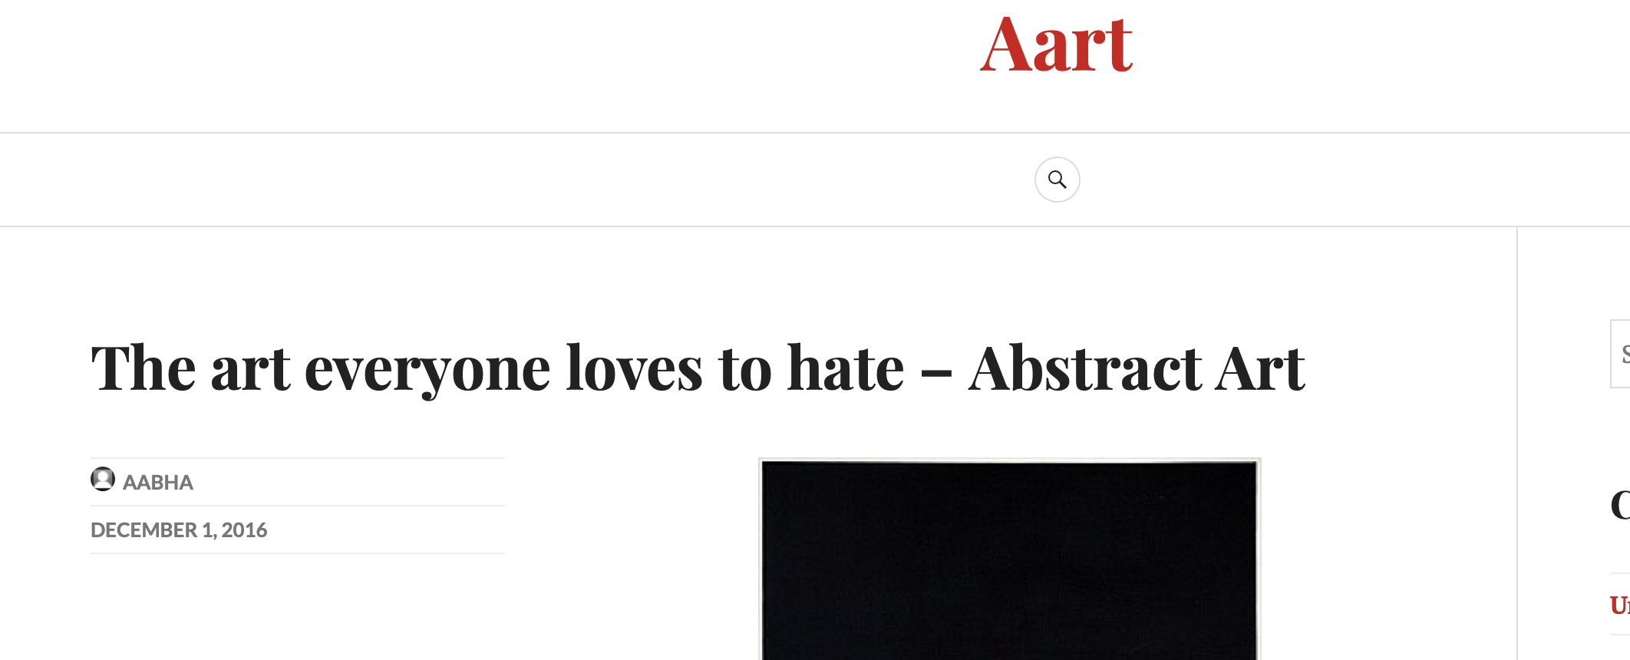
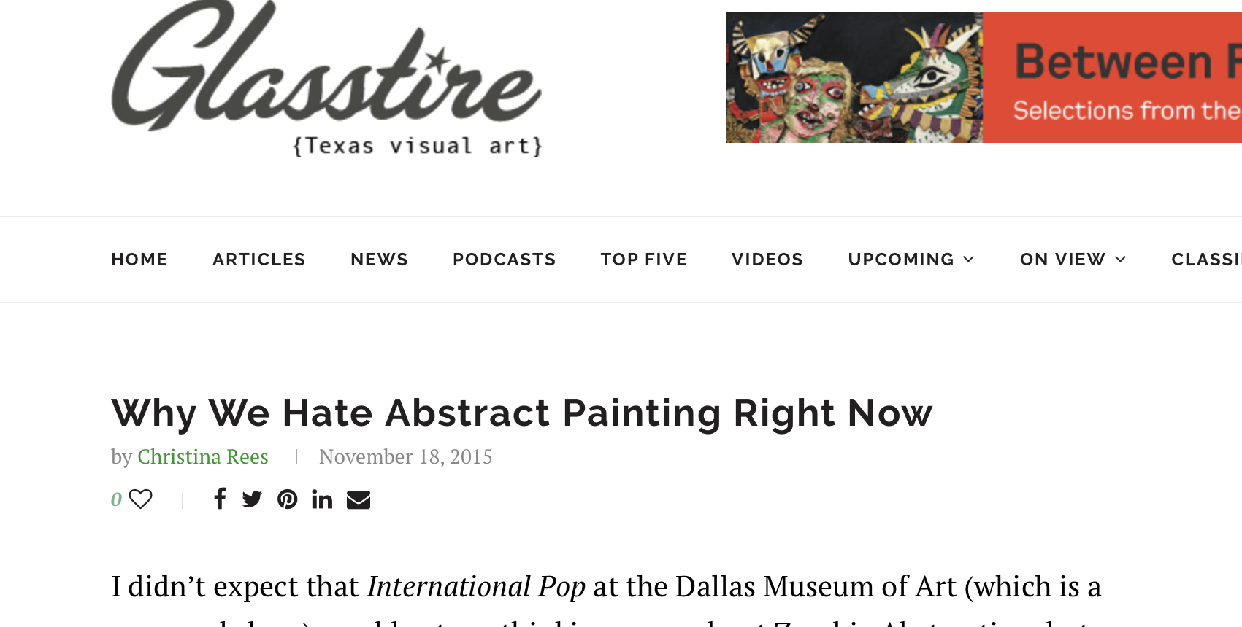
Modern art is underappreciated.

Slide 4
Common complaints
“I could have made that”
“What does it even mean?”
“Its just a mess on the canvas”

Slide 5
What can museums do to have audiences better appreciate this artform?

Slide 6
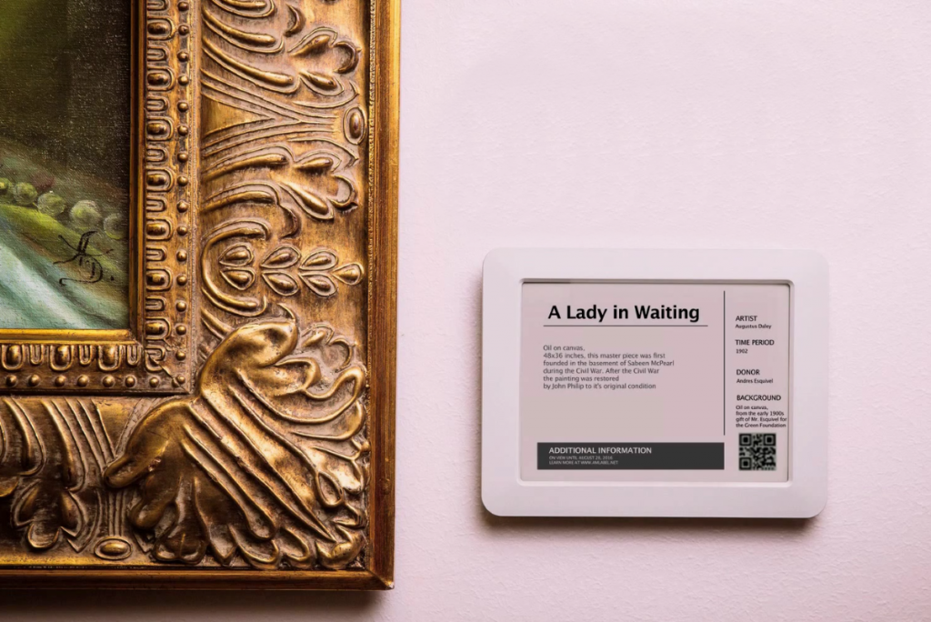
Museums can…
Show audiences what certain elements in a painting mean through labels or signs
Describe the artist’s overall intent and purpose for the painting
Attempt to create some type of meaning even in the most ambiguous paintings

Slide 7
Problems?
The original artist intent and purpose may be unknown to the museum
Artistic elements may be too ambiguous to interpret
Too impractical to create a new sign or display for every new piece of abstract art added to the museum

Slide 8
Proposal

Slide 9
A mobile application which can…
Use machine learning to scan and identify artistic elements in a painting
Use augmented-reality to superimpose information interpreting those elements
Provide other relevant information about the painting to the user

Slide 10

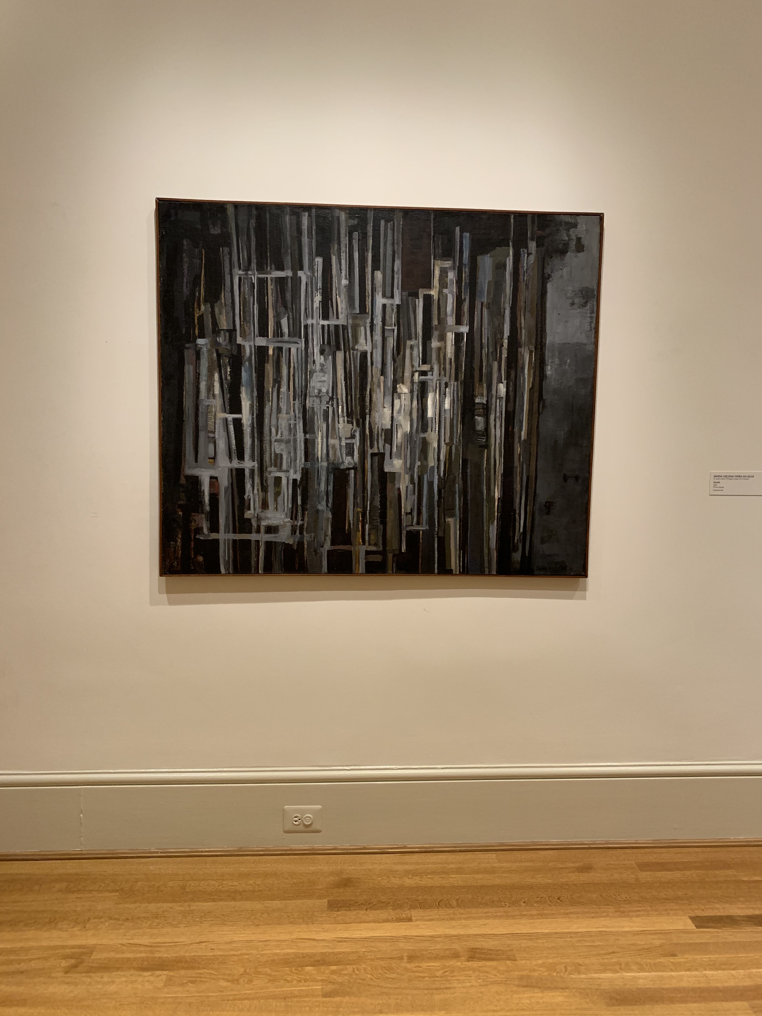
Example case
Vertical lines across painting may be used to indicate division of ideas
“Squares represent solidity, a perfection that is static, dependable, earthly and material.”
- Catherine Beyer
Use of black/greys
may be used to express negative emotions

Slide 11
Benefits
Provides insight into art otherwise seen as meaningless
Creates greater depth beyond what is simply visible to us
Use of machine learning alleviates the need to maintain a database filled with information on paintings in the Phillips inventory
Integrates both the digital and physical worlds

Slide 12
Research

Slide 13
Addressed research problems
Research will address the following:
How can museums incorporate technology with physical artwork?
How can museums better audience engagement?
How can audiences better appreciate works of art?

Slide 14
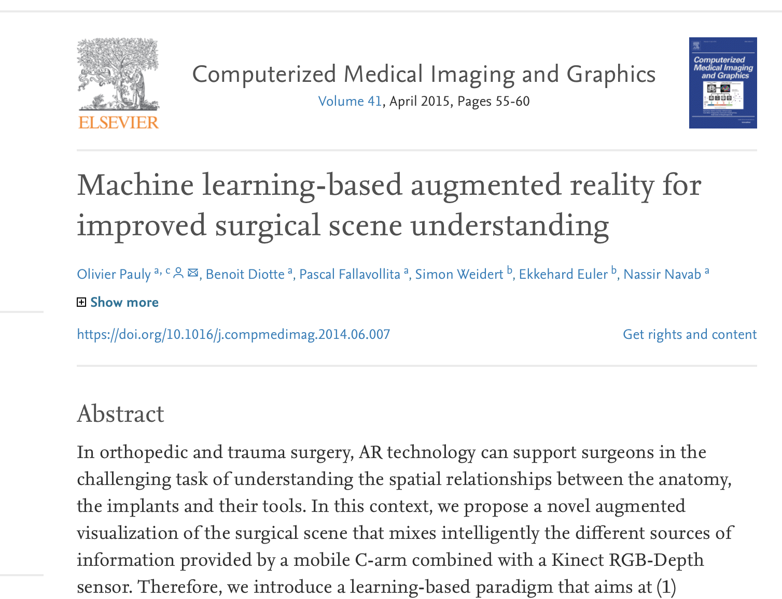
Prior research
Little research done using AR in conjunction with machine learning in a museum setting
One blended use case has been found in medicine
Pauly, O., Diotte, B., Fallavollita, P., Weidert, S., Euler, E., & Navab, N. (2015). Machine learning-based augmented reality for improved surgical scene understanding. Computerized Medical Imaging and Graphics,41, 55-60. doi:10.1016/j.compmedimag.2014.06.007

Slide 15
Design and Process
Research
Development
Testing
Ways of interpreting modern art
AR and ML development
Train a machine learning model
Create the mobile application
Test the application on various pieces of modern art
Acquire feedback

Slide 16
Impact
Change
Change the way people see abstract art
Increase
Increase appreciation and interest of modern art and art museums
Pioneer
Pioneer further blend of machine learning and AR

